Slide 1
Agile SCRUM Basics

Slide 2
What is Project
Simply, a project is a series of tasks that need to be completed in order to reach a specific outcome. A project can also be defined as a set of inputs and outputs required to achieve a particular goal. Projects can range from simple to complex and can be managed by one person or a hundred. Sometimes deadlines can be given or a time limitation. For good project productivity, some teams break the project up into individual tasks so they can manage accountability and utilize team strengths.
Faster Time-to-Market
Digital Transformation
Securing Brand and Customer Trust
Enhancing Operational Efficiency

Slide 3
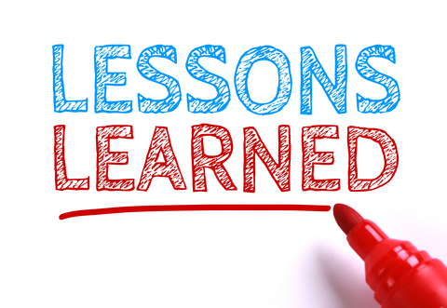
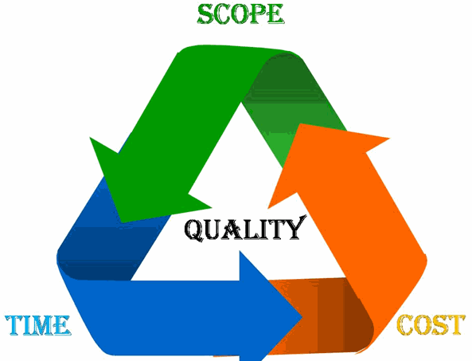
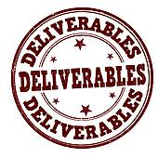
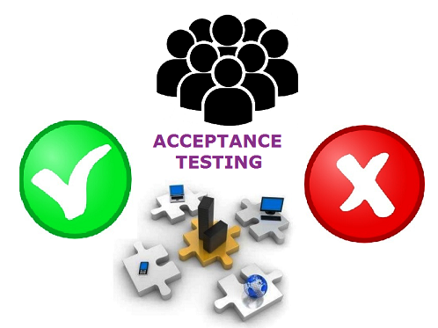

Project Life Cycle
Planned
Actuals
Project Conception/
Initiation
Close Project
Planning
Execution
Monitoring & Control
Planned
Project Charter
Project Management Plan
Status & Tracking
Vs.
Actuals
Risk
Resources

Slide 4
Agile Vs Scrum
Agile describes a set of guiding principles that uses iterative approach for software development, while Scrum is a specific set of rules that are to be followed while practicing the Agile software development.
Faster Time-to-Market
Digital Transformation
Securing Brand and Customer Trust
Enhancing Operational Efficiency

Slide 5
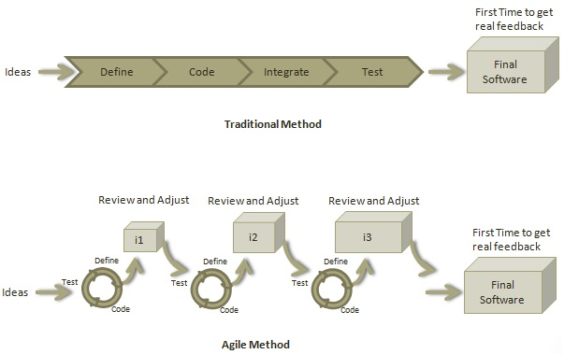
Agile Introduction
What is Agile?
Agile is a software development methodology to build a software incrementally using short iterations of 1 to 4 weeks so that the development is aligned with the changing business needs. Instead of a single-pass development of 6 to 18 months where all the requirements and risks are predicted upfront, Agile adopts a process of frequent feedback where a workable product is delivered after 1 to 4 week iteration.
Faster Time-to-Market
Digital Transformation
Securing Brand and Customer Trust
Enhancing Operational Efficiency

Slide 6
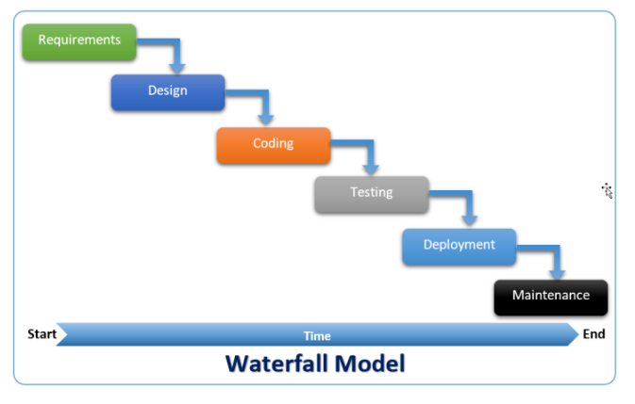
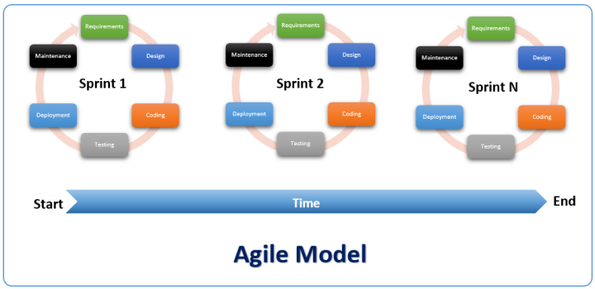
PLAN DRIVEN
CHANGE DRIVEN

Slide 7


Sequential vs. Overlapping development
Requirements
Design
Code
Test
Rather than doing all of one thing at a time...
...Agile teams do a little of everything all the time
Source: “The New New Product Development Game” by Takeuchi and Nonaka. Harvard Business Review, January 1986.

Slide 8
Roles in Agile
Following are the major roles in Agile Development
Scrum Master
Product Owner
Cross-functional Team or Development Team
Faster Time-to-Market
Digital Transformation
Securing Brand and Customer Trust
Enhancing Operational Efficiency

Slide 9
Scrum Master
A Scrum Master is a team leader and facilitator who helps the team members to follow agile practices so that they can meet their commitments. The responsibilities of a scrum master are as follows −
To enable close co-operation between all roles and functions.
To remove any blocks.
To shield the team from any external interferences.
To work with the organization to track the progress and processes of the company.
To ensure that Agile Inspect & Adapt processes are leveraged properly which includes
Daily stand-ups,
Planned meetings,
Demo,
Review,
Retrospective Meetings, and
To facilitate team meetings and decision-making process.
Faster Time-to-Market
Digital Transformation
Securing Brand and Customer Trust
Enhancing Operational Efficiency

Slide 10
Product Owner
A Product Owner is the one who drives the product from business perspective. The responsibilities of a Product Owner are as follows −
To define the requirements and prioritize their values.
To determine the release date and contents.
To take an active role in iteration planning and release planning meetings.
To adjust the features and priority every iteration, as needed
To ensure that team is working on the most valued requirement.
To represent the voice of the customer.
To accept the user stories that meet the definition of done and defined acceptance criteria.(Accept or reject work results)
Be responsible for the profitability of the product (ROI - Return on Investment)
Faster Time-to-Market
Digital Transformation
Securing Brand and Customer Trust
Enhancing Operational Efficiency

Slide 11
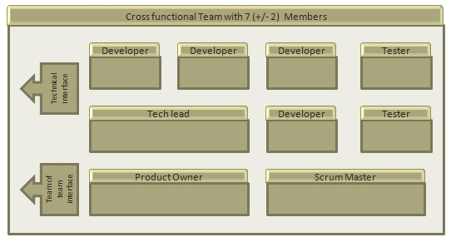
Cross-functional Team
Every agile team should be a self-sufficient team with 5 to 9 team members and an average experience ranging from of 6 to 10 years. Typically, an agile team comprises of 3 to 4 developers, 1 tester, 1 technical lead, 1 product owner and 1 scrum master.
Product Owner and Scrum master are considered to be a part of Team Interface, whereas other members are part of Technical Interface.
Faster Time-to-Market
Digital Transformation
Securing Brand and Customer Trust
Enhancing Operational Efficiency

Slide 12
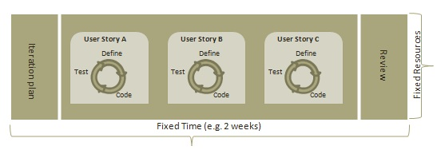
How an Agile Team plans it’s work
An Agile team works in iterations to deliver user stories where each iteration is of 10 to 20 days. The team uses its capacity − how many hours are available with team to work on tasks − to decide how much scope they have to plan.
Faster Time-to-Market
Digital Transformation
Securing Brand and Customer Trust
Enhancing Operational Efficiency

Slide 13
What is a User Story?
A user story is a requirement which defines what is required by the user as functionality. A user story can be in two forms −
As a <User Role> I want <Functionality> so that <Business Value>
In order to <Business value> as a <User Role> I want <Functionality>
During release planning, a rough estimate is given to a user story using relative scale as points. During iteration planning, the story is broken down into tasks.
Faster Time-to-Market
Digital Transformation
Securing Brand and Customer Trust
Enhancing Operational Efficiency

Slide 14
Point and Capacity
Point
A Point defines how much a team can commit. A point usually refers to 8 hours. Each story is estimated in points.
Capacity
Capacity defines how much an individual can commit. Capacity is estimated in hours.
Faster Time-to-Market
Digital Transformation
Securing Brand and Customer Trust
Enhancing Operational Efficiency

Slide 15
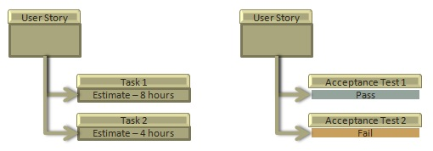
Relationship of User Stories and Tasks
User story talks about what is to be done. It defines what a user needs.
Task talks about how it is to be done. It defines how a functionality is to be implemented.
Stories are implemented by tasks. Each story is a collection of tasks.
User story is divided into tasks when it is planned in current iteration.
Tasks are estimated in hours
Stories are validated using acceptance tests.
Faster Time-to-Market
Digital Transformation
Securing Brand and Customer Trust
Enhancing Operational Efficiency

Slide 16
When a story is Done
The team decides what done means. The criteria may be −
All tasks (development, testing) are completed.
All acceptance tests are running and are passed.
No defect is open.
Product owner has accepted the story.
Deliverable to the end-user.
Faster Time-to-Market
Digital Transformation
Securing Brand and Customer Trust
Enhancing Operational Efficiency

Slide 17
What is Acceptance Criteria
Criteria defines the functionality, behavior, and performance required by a feature so that it can be accepted by the product owner. It defines what is to be done so that the developer knows when a user story is complete.
Faster Time-to-Market
Digital Transformation
Securing Brand and Customer Trust
Enhancing Operational Efficiency

Slide 18
How the requirements are defined?
Requirements are defined as
A User Story,
With Acceptance Criteria, and
Tasks to implement the story.
Faster Time-to-Market
Digital Transformation
Securing Brand and Customer Trust
Enhancing Operational Efficiency

Slide 19
Twelve Principles of Agile Manifesto
Customer Satisfaction − Highest priority is given to satisfy the requirements of customers through early and continuous delivery of valuable software.
Welcome Change − Changes are inevitable during software development. Ever-changing requirements should be welcome, even late in the development phase. Agile processes should work to increase customers' competitive advantage.
Deliver a Working Software − Deliver a working software frequently, ranging from a few weeks to a few months, considering shorter time-scale.
Collaboration − Business people and developers must work together during the entire life of a project.
Motivation − Projects should be built around motivated individuals. Provide an environment to support individual team members and trust them so as to make them feel responsible to get the job done.
Face-to-face Conversation − Face-to-face conversation is the most efficient and effective method of conveying information to and within a development team.
Faster Time-to-Market
Digital Transformation
Securing Brand and Customer Trust
Enhancing Operational Efficiency

Slide 20
Twelve Principles of Agile Manifesto
Face-to-face Conversation − Face-to-face conversation is the most efficient and effective method of conveying information to and within a development team.
Measure the Progress as per the Working Software − Working software is the key and it should be the primary measure of progress.
Maintain Constant Pace − Agile processes aim towards sustainable development. The business, the developers, and the users should be able to maintain a constant pace with the project.
Monitoring − Pay regular attention to technical excellence and good design to enhance agility.
Simplicity − Keep things simple and use simple terms to measure the work that is not completed.
Self-organized Teams − An agile team should be self-organized and should not depend heavily on other teams because the best architectures, requirements, and designs emerge from self-organized teams.
Review the Work Regularly − Review the work done at regular intervals so that the team can reflect on how to become more effective and adjust its behavior accordingly.
Faster Time-to-Market
Digital Transformation
Securing Brand and Customer Trust
Enhancing Operational Efficiency

Slide 21
Agile Characteristics
Following are 3 major characteristics of Agile:
Iterative/incremental and Ready to Evolve
Face-to-face Communication
Feedback Loop
Iterative/incremental and Ready to Evolve
Most of the agile development methods break a problem into smaller tasks. There is no direct long-term planning for any requirement. Normally, iterations are planned which are of vary short period of time, for example, 1 to 4 weeks. A cross-functional team is created for each iteration that works in all functions of software development like planning, requirements analysis, design, coding, unit testing, and acceptance testing. The result at the end of the iteration is a working product and it is demonstrated to the stakeholders at the end of an iteration.
After demo, review comments are taken and are planned to be incorporated in the working software as required.
Faster Time-to-Market
Digital Transformation
Securing Brand and Customer Trust
Enhancing Operational Efficiency

Slide 22
Agile Characteristics
Face-to-face Communication
Each agile team should have a customer representative such as a product owner in scrum methodology. This representative is authorized to act on behalf of the stakeholders and he can answer the queries of the developers in between iterations.
An information radiator (physical display) is normally located prominently in an office, where passers-by can see the progress of the agile team. This information radiator shows an up-to-date summary of the status of a project.
Faster Time-to-Market
Digital Transformation
Securing Brand and Customer Trust
Enhancing Operational Efficiency

Slide 23
Agile Characteristics
Feedback Loop
Daily stand-up is a common culture of any agile development; it is also known as daily scrum. It is a kind of a brief session where each team member reports to each other regarding the status of what they have done, what to do next, and any issues they are facing.
Faster Time-to-Market
Digital Transformation
Securing Brand and Customer Trust
Enhancing Operational Efficiency

Slide 24
Daily Stand-up
Daily stand-up, as the name suggests, is a daily status meeting among all the members of an agile team. It not only provides a forum for regular updates but also brings the problems of team members into focus so that it can be quickly addressed. Daily stand-up is a must-do practice, no matter how an agile team is established regardless of its office location.
So, A daily stand-up is a daily status meeting among all team members and it is held roughly for 15 minutes.
Every member has to answer three important questions −
What I did yesterday?
What I'll do today?
Any impediment I am facing.../ I am blocked due to...
Daily stand-up is for status update, not for any discussion. For discussion, team members should schedule another meeting at a different time.
Participants usually stand instead of sitting so that the meeting gets over quickly.
Faster Time-to-Market
Digital Transformation
Securing Brand and Customer Trust
Enhancing Operational Efficiency

Slide 25
Daily Stand-up
Why Stand-up is Important?
The benefits of having a daily stand-up in agile are as follows −
The team can evaluate the progress on a daily basis and see if they can deliver as per the iteration plan.
Each team member informs all about his/ her commitments for the day
It provides visibility to the team on any delay or obstacles.
Faster Time-to-Market
Digital Transformation
Securing Brand and Customer Trust
Enhancing Operational Efficiency

Slide 26
Daily Stand-up
Who Attends a Stand-up?
The scrum master, the product owner, and the delivery team should attend the stand-up on a daily basis.
Stakeholders and Customers are encouraged to attend the meeting and they can act as an observer, but they are not supposed to participate in stand-ups.
It is the scrum master's responsibility to take note of each team member's queries and the problems they are facing.
Faster Time-to-Market
Digital Transformation
Securing Brand and Customer Trust
Enhancing Operational Efficiency

Slide 27
Daily Stand-up
Geographically Dispersed Teams
Stand-ups can be done in multiple ways, in case the agile team members are operating from different time zones −
Select a member on a rotational basis, who can attend the stand-up meeting of teams located in different time zones.
Have a separate stand-up per team, update the status of the stand-up in a tool such as Rally, SharePoint, Wikis, etc.
Have a wide variety of communication tools ready like conference call, video conferencing, instant messengers, or any other third-party knowledge sharing tools.
Faster Time-to-Market
Digital Transformation
Securing Brand and Customer Trust
Enhancing Operational Efficiency

Slide 28
Definition of Done
The definition of done for User Story
A user story is a requirement which is formulated in a few sentences in everyday language of an user and it should be completed within an iteration. A user story is done when
All the related code have been checked-in.
All the unit test cases have been passed.
All the acceptance test cases have been passed.
Help text is written.
Product Owner has accepted the story.
Faster Time-to-Market
Digital Transformation
Securing Brand and Customer Trust
Enhancing Operational Efficiency

Slide 29
Definition of Done
The definition of done for Iteration
An iteration is a time boxed collection of user stories / defects to be worked upon and accepted within the release of a product. Iterations are defined during iteration planning meeting and completed with an iteration demo and review meeting. An iteration is also termed as a sprint. An iteration is done when
Product backup is complete.
Performance has been tested.
User stories have been accepted or moved to the next iteration.
Defects have been fixed or postponed to the next iteration.
Faster Time-to-Market
Digital Transformation
Securing Brand and Customer Trust
Enhancing Operational Efficiency

Slide 30
Definition of Done
The definition of done for Release
A release is a major milestone that represents an internal or external delivery of working, tested version of the product/system. A release is done when
System is stress tested.
Performance is tuned.
Security validations are carried out.
Disaster recovery plan is tested.
Faster Time-to-Market
Digital Transformation
Securing Brand and Customer Trust
Enhancing Operational Efficiency

Slide 31
Release Planning
The purpose of release planning is to create a plan to deliver an increment to the product. It is done after every 2 to 3 months.
Who is Involved?
Scrum Master − The scrum master acts as a facilitator for the agile delivery team.
Product Owner − The product owner represents the general view of the product backlog.
Agile Team − Agile delivery team provides insights on the technical feasibilities or any dependencies.
Stakeholders − Stakeholders like customers, program managers, subject matter experts act as advisers as decisions are made around the release planning.
Faster Time-to-Market
Digital Transformation
Securing Brand and Customer Trust
Enhancing Operational Efficiency

Slide 32
Release Planning
Prerequisites of Planning
The prerequisites of release planning are as follows −
A ranked product backlog, managed by the Product Owner. Generally five to ten features are taken which the product owner feels that can be included in a release
Team's input about capabilities, known velocity or about any technical challenge
High-level vision
Market and Business objective
Acknowledgement whether new product backlog items are needed
Faster Time-to-Market
Digital Transformation
Securing Brand and Customer Trust
Enhancing Operational Efficiency

Slide 33
Release Planning
Materials Required
The list of materials required for release planning is as follows −
Posted agenda, purpose
Flip charts, whiteboards, markers
Projector
Planning data
Faster Time-to-Market
Digital Transformation
Securing Brand and Customer Trust
Enhancing Operational Efficiency

Slide 34
Release Planning
Planning Data
The list of data required to do release planning is as follows −
Previous iterations or release planning results
Feedback from various stakeholders on product, market conditions, and deadlines
Action plans of previous releases / iterations
Features or defects to be considered
Velocity from previous releases/ estimates
Organizational and personal calendars
Inputs from other teams and subject matter experts to manage any dependencies
Faster Time-to-Market
Digital Transformation
Securing Brand and Customer Trust
Enhancing Operational Efficiency

Slide 35
Release Planning
Output
The output of a release planning can be the following −
Release plan
Commitment
Issues, concerns, dependencies, and assumptions which are to be monitored
Suggestions to improve future release plannings
Faster Time-to-Market
Digital Transformation
Securing Brand and Customer Trust
Enhancing Operational Efficiency

Slide 36
Iteration Planning
The purpose of iteration planning is for the team to complete the set of top-ranked product backlog items. This commitment is time boxed based on the length of iteration and team velocity.
Who is Involved?
Scrum Master − The scrum master acts as a facilitator for the agile delivery team.
Product Owner − The product owner deals with the detailed view of the product backlog and their acceptance criteria.
Agile Team − Agile delivery defines their tasks and sets the effort estimates required to fulfil the commitment.
Faster Time-to-Market
Digital Transformation
Securing Brand and Customer Trust
Enhancing Operational Efficiency

Slide 37
Iteration Planning
Prerequisites of Planning
Items in product backlog are sized and have a relative story point assigned.
Faster Time-to-Market
Digital Transformation
Securing Brand and Customer Trust
Enhancing Operational Efficiency

Slide 38
Iteration Planning
Planning Process
Following are the steps involved in iteration planning −
Determine how many stories can fit in an iteration.
Break these stories into tasks and assign each task to their owners.
Each task is given estimates in hours.
These estimates help team members to check how many task hours each member have for the iteration.
Team members are assigned tasks considering their velocity or capacity so that they are not overburdened.
Faster Time-to-Market
Digital Transformation
Securing Brand and Customer Trust
Enhancing Operational Efficiency

Slide 39
Iteration Planning
Velocity Calculation
An agile team calculates velocity based on past iterations. Velocity is an average number of units required to finish user stories in an iteration. For example, if a team took 12, 14, 10 story points in each iteration for the last three iterations, the team can take 12 as velocity for the next iteration.
Planned velocity tells the team how many user stories can be completed in the current iteration. If the team quickly finishes the tasks assigned, then more user stories can be pulled in. Otherwise, stories can be moved out too to the next iteration.
Faster Time-to-Market
Digital Transformation
Securing Brand and Customer Trust
Enhancing Operational Efficiency

Slide 40
Iteration Planning
Task Capacity
The capacity of a team is derived from the following three facts −
Number of ideal working hours in a day
Available days of person in the iteration
Total no of members in team
Suppose a team has 5 members, committed to work full time (8 hours a day) on a project and no one is on leave during an iteration, then the task capacity for a two-week iteration will be −
5 × 8 × 10 = 400 hours
Faster Time-to-Market
Digital Transformation
Securing Brand and Customer Trust
Enhancing Operational Efficiency

Slide 41
Iteration Planning
Planning Steps
Product Owner describes the highest ranked item of product backlog.
Team describes the tasks required to complete the item.
Team members own the tasks.
Team members estimate the time to finish each task.
If any individual is overloaded with tasks, then his/her task is distributed among other team members.
Faster Time-to-Market
Digital Transformation
Securing Brand and Customer Trust
Enhancing Operational Efficiency

Slide 42
Product Backlog
A product backlog is a list of items to be done. Items are ranked with feature descriptions. In an ideal scenario, items should be broken down into user stories.
Importance
It is prepared so that estimates can be given to each and every feature.
It helps in planning the roadmap for the product.
It helps in determining what to prioritize first. Team ranks the item and then builds value.
Characteristics of Product Backlog
Each product should have one product backlog which can have a set of large to very large features.
Multiple teams can work on a single product backlog.
Ranking of features is done based on business value, technical value, risk management or strategic fitness.
Highest ranking items are decomposed into smaller stories during release planning so that they can be completed in future iterations.
Faster Time-to-Market
Digital Transformation
Securing Brand and Customer Trust
Enhancing Operational Efficiency

